Slide 1

Visual Displays of Data
Chapter 3

Slide 2
Uses of Graphs
Positive and negative uses
Can accurately and succinctly present information
Can reveal/conceal complicated data
Graphing in the information age: a critical skill
http://www.datavis.ca/gallery/

Slide 3
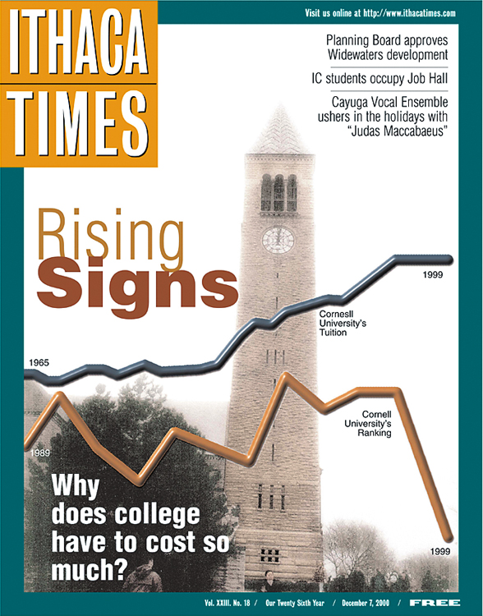
“The Most Misleading Graph Ever Published”
How to Mislead with Graphs
The Cost and Quality of Higher Education

Slide 4
“The Most Misleading Graph Ever Published”
So why bad?
The times are not the same for both lines (going across)
The scales are not the same
So the starting point is also a problem
Rankings … down = BETTER, so why did they graph ranks that way?

Slide 5
Techniques for Misleading
The false face validity lie
Method seems to represent what it says, but does not actually.
e.g., using yelling as a measure of aggression

Slide 6
Techniques for Misleading
The biased scale lie
Scaling to skew the results, or leading questions
i.e. goodreads book scale (did not like, it was ok, liked it, really liked it, it was amazing)

Slide 7
Techniques for Misleading
The sneaky sample lie
When participants are preselected or self selected to provide data.
Like rate my professor!

Slide 8
More Techniques
The interpolation lie
Assumes that a value between 2 data points follows the same pattern
The extrapolation lie
Assumes knowledge outside of the study

Slide 9
More Techniques
The inaccurate values lie
Uses scaling to distort portions of the data
The outright lie:
Making up data!

Slide 10
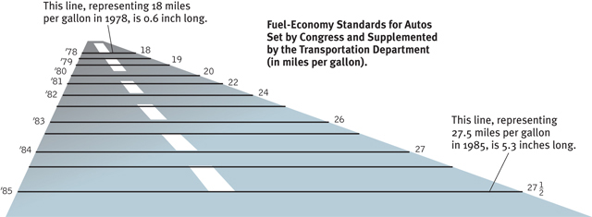
The Inaccurate Value Lie

Slide 11
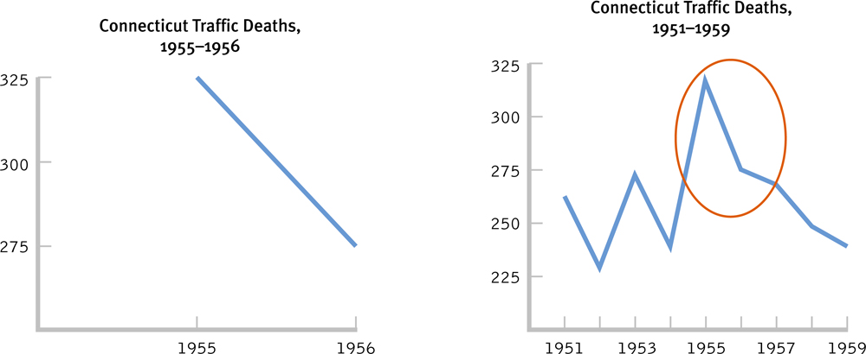
Which of the two graphs is misleading?

Slide 12
Common Types of Graphs
Scatterplots
Graphs that depict the relation between two scale variables
Range-frame (!!) – x and y axis show the range of the variable
Observing every data point
Linear relationships – relationship between variables is a straight line
Nonlinear relationships – relationship between variables is curved
Performance & Anxiety

Slide 13
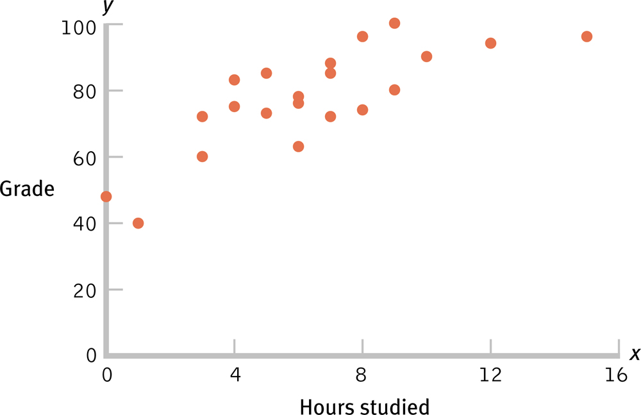
Scatterplot of Hours Studied and Statistics Grade

Slide 14
How-To R
Be sure you load the ggplot library!
We are going to use the airquality dataset.
data(airquality), head(airquality)

Slide 15
How-To R
First build a blank plot.
myplot = ggplot(dataset, aes(X axis column, Y axis column))
Example: myplot = ggplot(airquality, aes(Temp, Ozone))

Slide 16
How-To R
Add dots to it!
geom_point()
Man, that’s still an ugly graph…how can we clean it up?

Slide 17
How-To R
Run this cleanup code:
cleanup = theme(panel.grid.major = element_blank(), panel.grid.minor = element_blank(), panel.background = element_blank(),
axis.line.x = element_line(color = "black"),
axis.line.y = element_line(color = "black"), legend.key = element_rect(fill = "white"),
text = element_text(size = 15))

Slide 18
How-To R
Now do,
myplot + geom_point() + cleanup
Much nicer!
Now, how can we change other things about the graph?
How about x and y axis labels?

Slide 19
How-To R
+ xlab(“Text goes here”)
+ ylab(“Text goes here”)

Slide 20
Line Graphs
Line graphs are best for scale variables (remember this is interval/ratio)
Especially useful for trends over time
Line of best fit
Time series plot

Slide 21
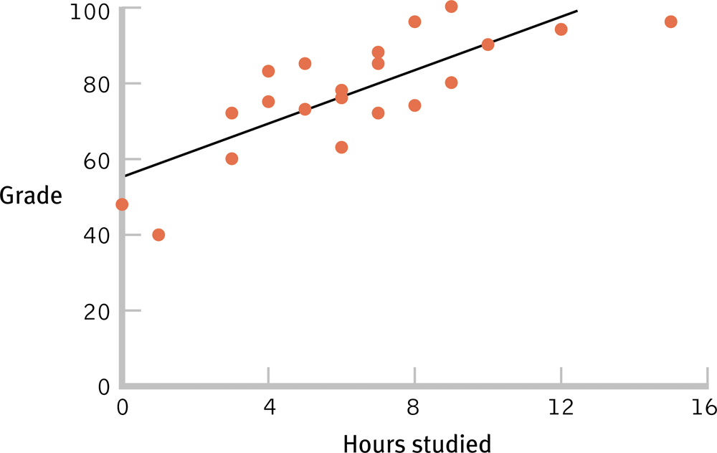
The Line of Best Fit

Slide 22
How-To R
Let’s add a line of best fit!
+ geom_smooth()
Oh, that’s not quite straight.
Let’s do this instead!
geom_smooth(method = “lm”)

Slide 23
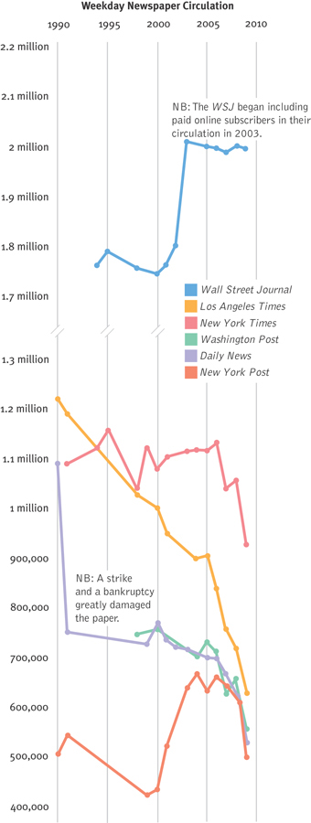
Weekly Newspaper Circulation

Slide 24
Bar Graphs
When the independent variable is nominal or ordinal and the dependent variable is scale
Meaning X = groups, Y = interval/ratio
Each bar usually represents and AVERAGE score.

Slide 25
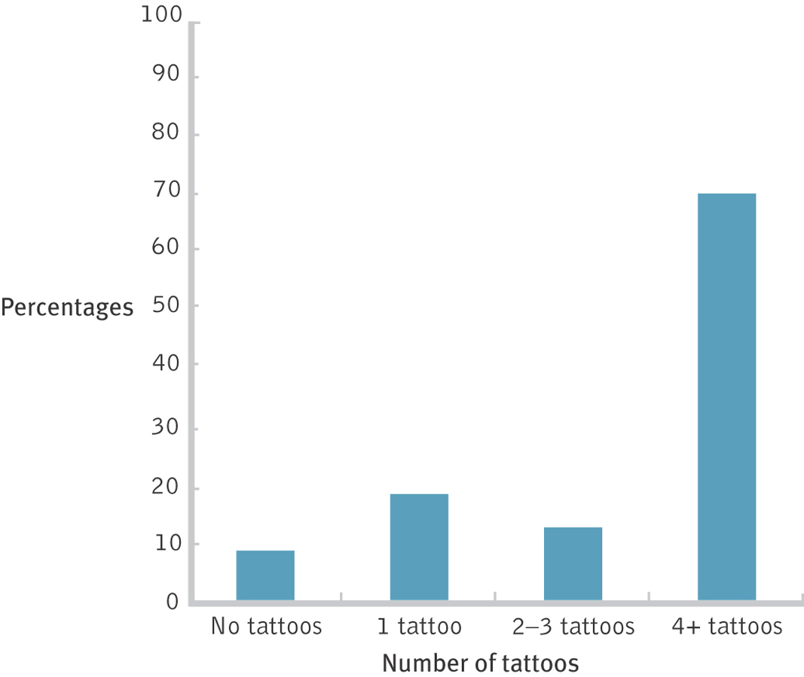
Bar Graphs Highlight Differences Between Means

Slide 26
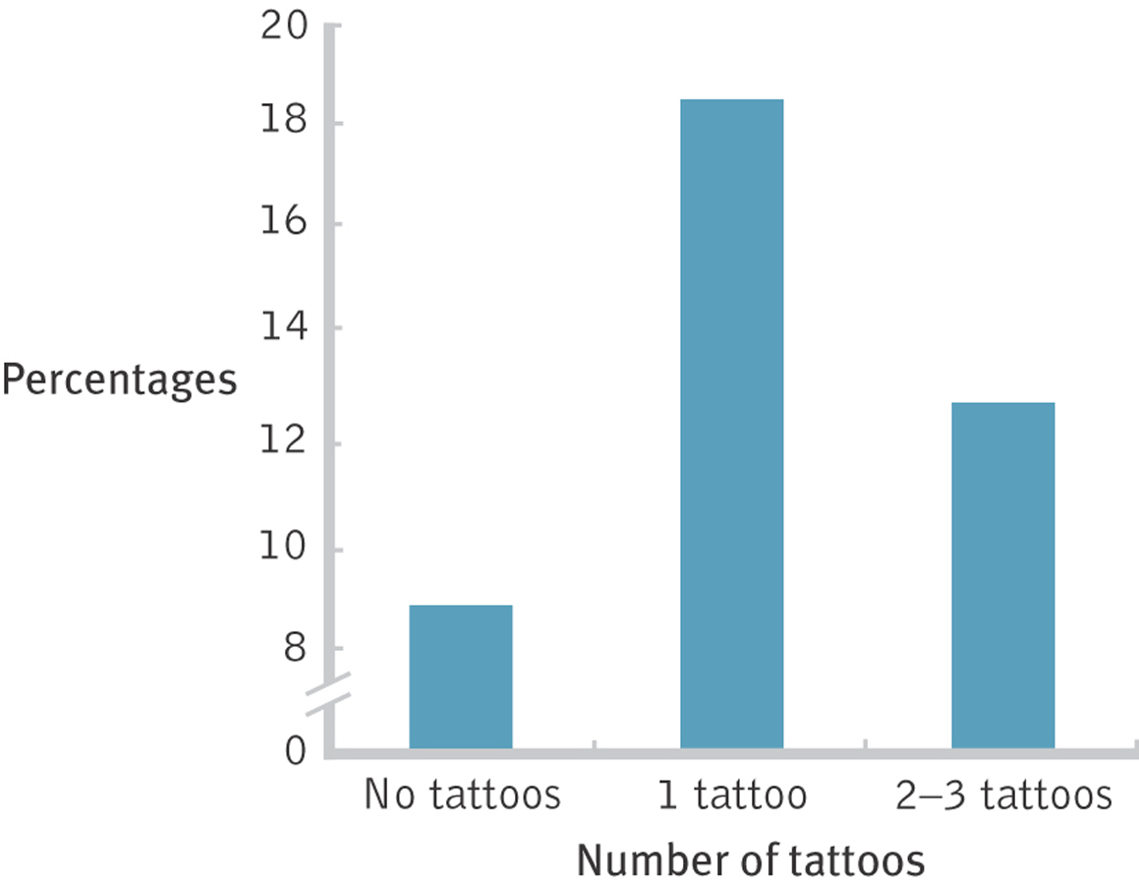
Deceiving with the Scale

Slide 27
How-To R
First, build a blank plot.
myplot = ggplot(dataset, aes(X axis column, Y axis column))
But now, the X axis column will be categorical, the Y axis column will be continuous

Slide 28
How-To R
myplot = ggplot(airquality, aes(Month, Temp))
Month is an integer at the month, let’s fix it!
The factor() command allows us to take numeric variables and switch them to text.
factor(column,
levels = c(stuff that’s in the column already),
Labels = c(stuff you want to change it to))

Slide 29
How-To R
+ stat_summary(fun.y = mean,
geom = "bar",
fill = "White",
color = "Black")

Slide 30
How-To R
+ stat_summary(fun.data = mean_cl_normal, geom = "errorbar",
position = position_dodge(width = 0.90),
width = 0.2)

Slide 31
Check Your Learning
What is the best type of graph to depict the following:
Depression levels and stress levels for 150 university students. Is depression related to stress?
Mean years of education for six regions of the United States. Are education levels higher in some regions than in others?

Slide 32
Choosing the Graph Based on Variables
One scale variable (with frequencies): histogram or frequency polygon
One scale independent and one scale dependent variable: scatterplot or line graph
One nominal or ordinal independent and one scale dependent variable: bar graph
Two+ nominal or ordinal independent and one interval dependent variable: bar graph

